Slide 1

Eventual consistency done right

Slide 2
What Are We Going To COVER
Consistency Between Services
Communication Between Services
Using A Message Broker
Messages Resiliency
The Outbox Pattern

Slide 3
Consistency Between Services
The challenge is to implement end-to-end business processes while keeping consistency across microservices
Catalog microservice - maintains information about products (including price)
Shopping Cart microservice - maintains current chosen products and price
When a product price is updated - you need to update the cart too (and show a message)
In monolithic application this should be fairly easy
But with microservices - no service should include tables/storage from another one
And it should never call direct queries to them
The solution is event-based communication
Publish-Subscribe pattern

Slide 4
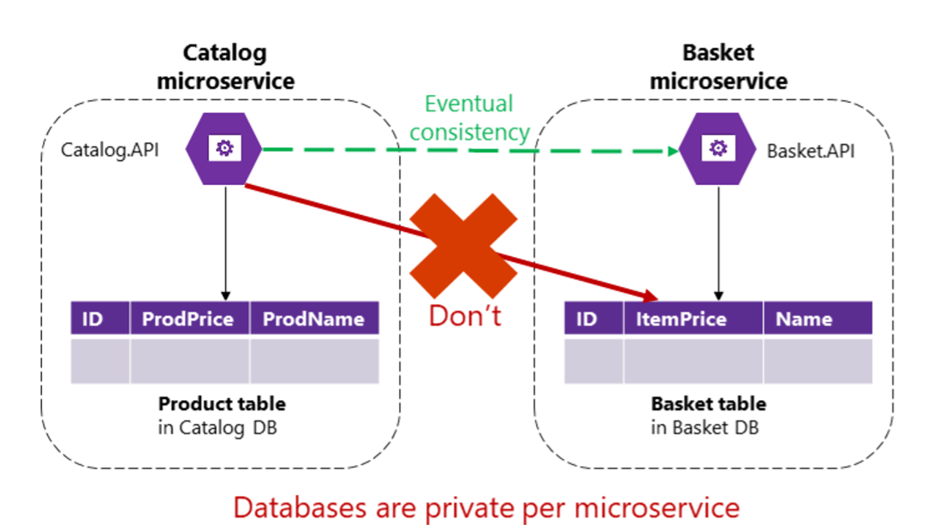
Consistency Between Services

Slide 5
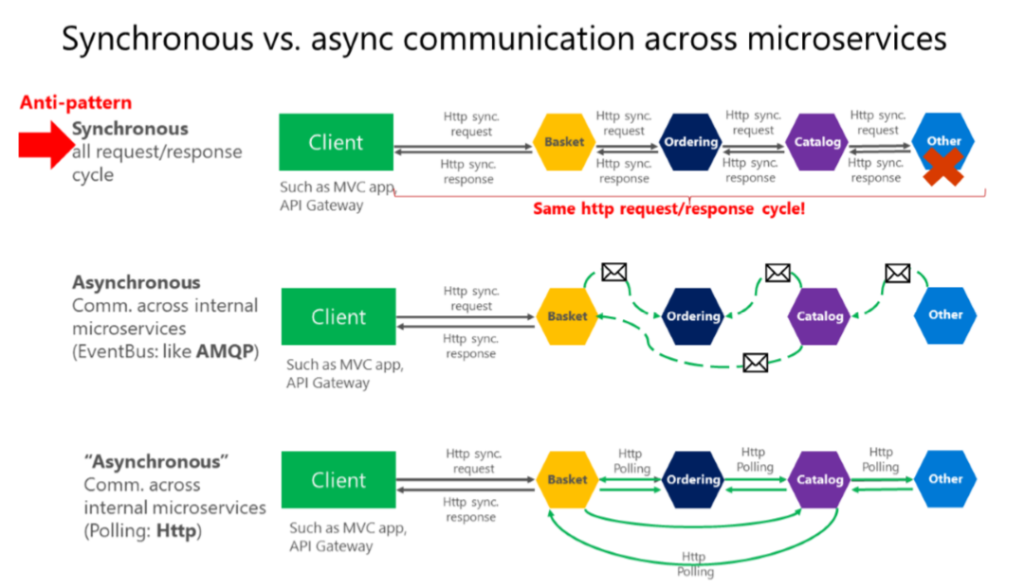
Consistency Between Services

Slide 6
Communication Between Services
The challenge about communication is not so much about the protocols
But more about the style and couplings
Because when failure occurs - the more coupled the system, the bigger issues you will have
Partial failures will happen, so you need to design the system considering the common risks

Slide 7
Communication Between Services
Popular approach is HTTP, because it is simple
HTTP is perfectly acceptable, but it depends on how you use it
Acceptable HTTP requests are
Client-Microservice
Client-API Gateway
API Gateway-Microservice
Unacceptable HTTP requests are
Microservice-Microservice

Slide 8
Consistency Between Services
These are the pitfalls
Blocking and low performance - scalability is impacted
HTTP coupling on a business level - this should not occur
Failure will be difficult to manage - and failures occur
This way - we achieve a monolithic application across many processes
Solution is event-driven asynchronous communication

Slide 9
Communication Between Services
Don't rely on request-response, if possible
If you need data from another microservice, consider duplicating it, it's perfectly OK!
If your microservice needs to invoke an action in another microservice do it asynchronously
You can use any protocol to transfer data to have eventual consistency
But don't create synchronous dependencies by waiting for responses

Slide 10
Communication Between Services
Asynchronous messages:
Critical for propagating changes throughout multiple services
Eventual consistency + event-driven communication
A client send a message (header and body) and do not expect a response
If the service needs to return a response - it sends another message
Usually sent asynchronously through AMQP

Slide 11
Communication Between Services
The preferred infrastructure is a lightweight message broker
Like RabbitMQ or a cloud-ready service bus
The rules are:
Use HTTP for client + API Gateway + First microservice level (Frontend microservices)
Use AMQP for service level (Backend microservices)

Slide 12
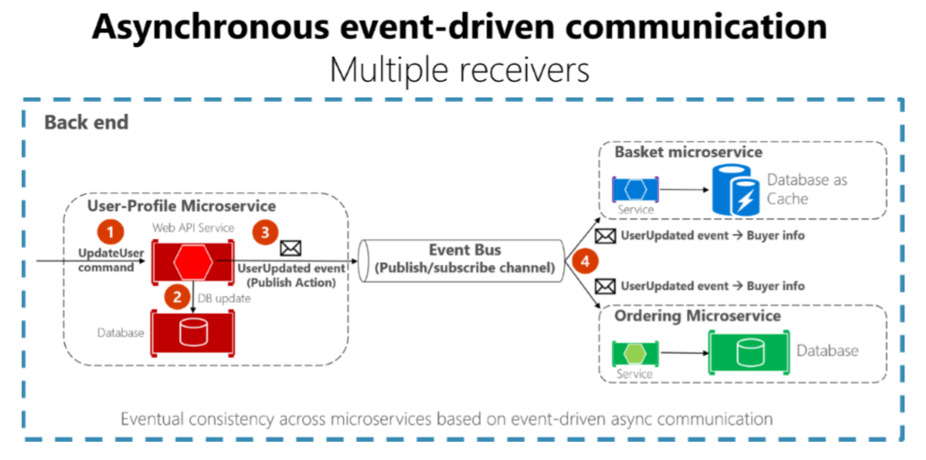
Communication Between Services

Slide 13
Using A Message Broker
Go to https://www.rabbitmq.com/
Follow the guide to install the message broker for your operational system
You may need to install Erlang too
You can configure its port and user access, but it is not required for a development environment
Make sure RabbitMQ is up and running

Slide 14
Using A Message Broker
Install MassTransit.AspNetCore
Install MassTransit.RabbitMQ
Should be added to all web projects
Register the RabbitMQ broker with MassTransit in your services
Create your message classes
Create your consumer classes
And register them in your MassTransit configuration

Slide 15
Using A Message Broker
services // Register the message broker
.AddMassTransit(mt => {
consumers.ForEach(consumer => mt.AddConsumer(consumer));
mt.AddBus(context => Bus.Factory.CreateUsingRabbitMq(rmq =>
{
rmq.Host("localhost");
consumers.ForEach(consumer => rmq.ReceiveEndpoint(
consumer.FullName, endpoint => endpoint
.ConfigureConsumer(context, consumer)));
}); })
.AddMassTransitHostedService();

Slide 16
Using A Message Broker
// Create a message class and publish it from IBus in your logic
public class CarAdCreatedMessage
{
public int CarAdId { get; set; }
public string Manufacturer { get; set; }
public string Model { get; set; }
public decimal PricePerDay { get; set; }
}

Slide 17
Using A Message Broker
// Create a consumer for the specific message and register it in your Startup
public class CarAdCreatedConsumer : IConsumer<CarAdCreatedMessage>
{
private readonly IStatisticsService statistics;
public CarAdCreatedConsumer(IStatisticsService statistics)
=> this.statistics = statistics;
public async Task Consume(ConsumeContext<CarAdCreatedMessage> context)
=> await this.statistics.AddCarAd();
}

Slide 18
Messages Resiliency
// Configure message retries
consumers.ForEach(consumer => rmq
.ReceiveEndpoint(consumer.FullName, endpoint =>
{
endpoint.PrefetchCount = 12; // Number of CPUs is default
endpoint.UseMessageRetry(x => x.Interval(5, 100));
endpoint.ConfigureConsumer(bus, consumer);
}));

Slide 19
The problem with current approach

Slide 20
The Outbox Pattern
Create an additional table holding the integration events between microservices
Before publishing to the event bus – create a local database transaction
Updating the entity and saving the event as “pending”
Publish the event for the other microservices
If the publishing is successful – mark the event as “completed” with a new transaction
Have a background job to check periodically for failed “pending” events and publish them to the event bus
Guarantees you eventual consistency
Make sure you save yourself from database failures too!

Slide 21
The Outbox Pattern
The receiver microservice should do one of the following
Make sure the operations can be performed multiple times without affecting the result
Recognize duplicated messages and discard them
Idempotent messages:
Should be like “set the price to $40.00”
And not like “add $5.00 to the price”
Recognizing events can be done by adding a GUID to every event
Or use the infrastructure’s built-in features

Slide 22
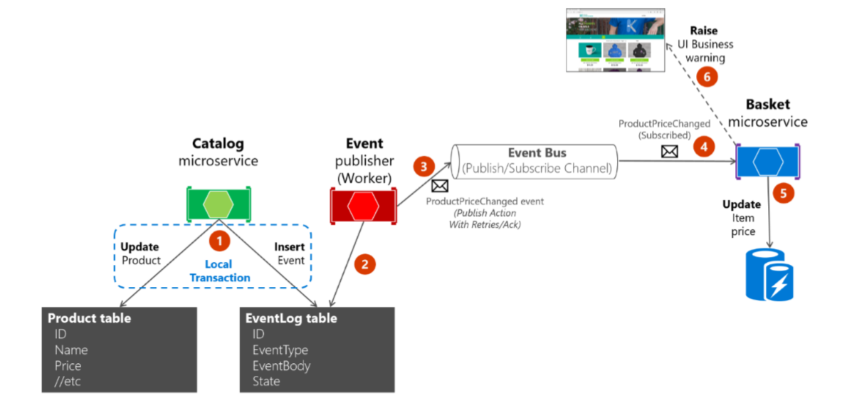
Communication Between Services

Slide 23
Messages Resiliency
// Add a global Message model
private string serializedData; // Note: this is a field!
public int Id { get; set; }
public Type Type { get; set; }
public bool Published { get; set; }
[NotMapped]
public object Data
{ // Make sure you ignore null values!
get => JsonConvert.DeserializeObject(this.serializedData, this.Type);
set => this.serializedData = JsonConvert.SerializeObject(value);
}

Slide 24
Messages Resiliency
// Add Entity Framework configuration
builder.HasKey(m => m.Id);
builder.Property<string>("serializedData").IsRequired()
.HasField("serializedData");
builder.Property(m => m.Type).IsRequired()
.HasConversion(
t => t.AssemblyQualifiedName,
t => Type.GetType(t));

Slide 25
Messages Resiliency
// Add base DbContext
public DbSet<Message> Messages { get; set; }
protected abstract Assembly ConfigurationsAssembly { get; }
protected override void OnModelCreating(ModelBuilder builder)
{
builder.ApplyConfiguration(new MessageConfiguration());
builder.ApplyConfigurationsFromAssembly(this.ConfigurationsAssembly);
base.OnModelCreating(builder);
}

Slide 26
Messages Resiliency
// Add services to save messages in the database
// Saving entities and messages should be in a transaction!
public interface IDataService<in TEntity>
where TEntity : class
{
Task MarkMessageAsPublished(int id);
Task Save(TEntity entity, params Message[] messages);
}

Slide 27
The Outbox Pattern
Install HangFire:
HangFire.Core
HangFire.SqlServer
Hangfire.AspNetCore
Register the dashboard (available at /hangfire)
if (app.ApplicationServices.GetService<MessagesHostedService>() != null)
{
app.UseHangfireDashboard();
}

Slide 28
Messages Resiliency
// Register HangFire
services
.AddHangfire(config => config
.SetDataCompatibilityLevel(CompatibilityLevel.Version_170)
.UseSimpleAssemblyNameTypeSerializer()
.UseRecommendedSerializerSettings()
.UseSqlServerStorage("connectionString"));
services.AddHangfireServer();
services.AddHostedService<MessagesHostedService>();

Slide 29
Messages Resiliency
// Create a HostedService using IRecurringJobManager
public Task StartAsync(CancellationToken cancellationToken)
{
this.jobManager.AddOrUpdate(
nameof(MessagesHostedService),
() => this.ProcessMessages(),
"*/5 * * * * *");
return Task.CompletedTask;
}

Slide 30
Messages Resiliency
// Process all unpublished messages
public void ProcessMessages()
{
var messages = this.data.Set<Message>()
.Where(m => !m.Published).ToList();
foreach (var message in messages)
{
this.publisher.Publish(message.Data, message.Type).GetAwaiter().GetResult();
message.Published = true;
this.data.SaveChanges();
}
}

Slide 31
ANY QUESTIONS?

